Slide 1




Funded by:
Partnered with:

Slide 2
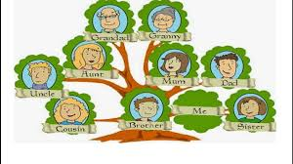
BLOOD RELATIONS

Slide 3
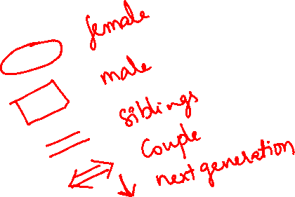
Given below are the names of the various kinds of relations in a family:
Unmarried man : Bachelor
Unmarried woman : Spinster
Parents : Father, Mother
Siblings : Brother, Sister
Spouse : Husband, Wife
Uncle : Mother’s/Father’s brother
Aunt : Mother’s/Father’s sister
Nephew : Sister’s/Brother’s son
Niece : Sister’s/Brother’s daughter
Cousin : Uncle/Aunt’s son or daughter
All the above relations become in-laws, for a person’s relation through either husband/wife

Slide 4
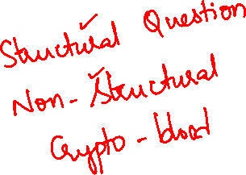
Blood relations symbols
Female
Male
Siblings
Couple
Next generation

Slide 5
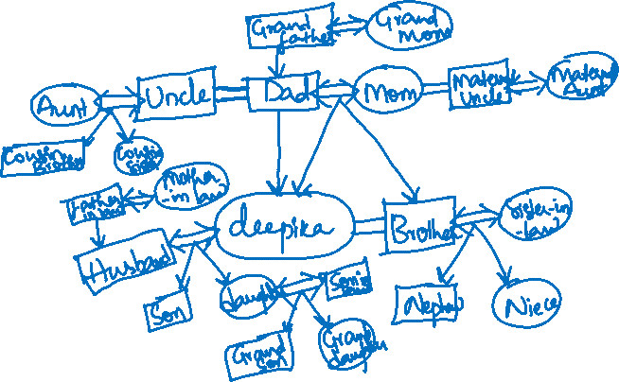
Family chart

Slide 6
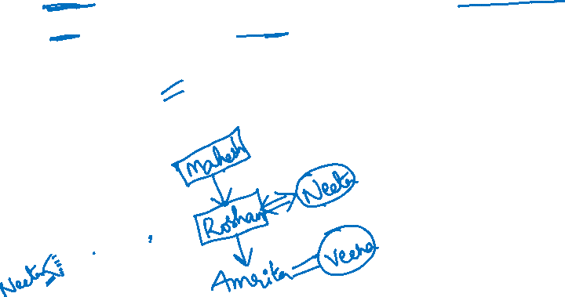
If Neeta says amrita’s father Roshan is the only son of my father-in-law mahesh then how is veena sister of amrita related to mahesh?
a) Daughter b) grand daughter c) aunt d)sister

Slide 7
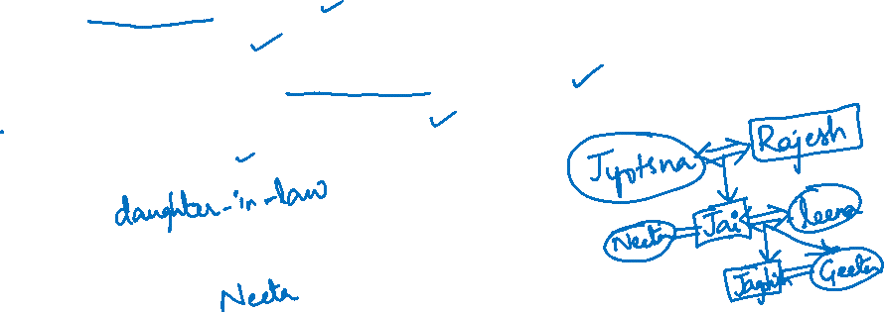
In a family of 3 generations there are 2 couples and 2 pairs of brothers and sisters
Neeta is sister-in-law of Leena
Geeta is daughter of Jai
Jyotsna and Rajesh are the eldest couple in the family
Jai is son of Rajesh, and his wife is Leena
Jagdish is son of Leena
1) Leena is___________ of Rajesh ?
2) Who is aunt of Jagdish ?

Slide 8
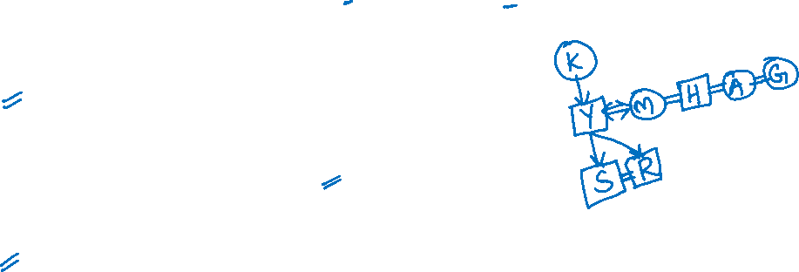
In a family Y is father of S. M is wife of Y and K is mother of Y and Y has two sons and No daughter. S is brother of R. A and G are sisters of H, who is brother of M, then find the relation for given questions?
How is M related to S?
a) Mother b) Grand mother c) Sister d) Daughter
How is A related to S?
a) Mother b) Grand mother c) Aunt d) Daughter
How is H related to A?
a) Brother b) Sister c) Uncle d) Data inadequate

Slide 9

How is M related to A?
a)Brother b) Sister c) Uncle d) Data inadequate
How is H related to Y?
a) Father b) Grand father c) Uncle d) Brother-in-law
How is H related to R?
a) Brother b) Sister c) Uncle d) Nephew

Slide 10
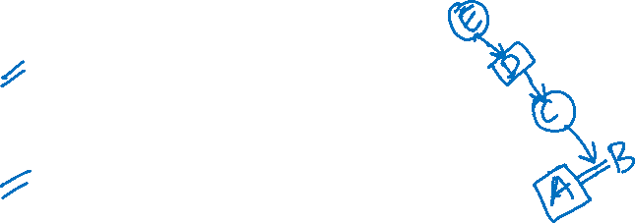
A is B’s brother. C is B’s mother. D is C’s father and E is D’s mother. Then
1) How is A related to D ?
a) grand mother b)grandson c)great-grandson d)none
2) How is E related to A ?
a) grand mother b)great grand mother c)grand father
d)great grand father

Slide 11
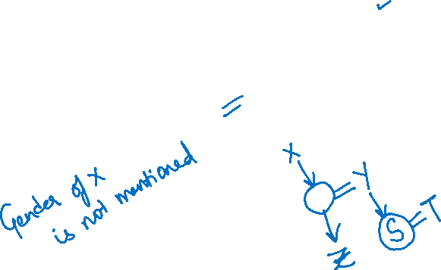
Z’s mother is sister of Y and daughter of X
S is daughter of Y and sister of T.
How is X related to T ?
a) Father b) Grandfather c) cannot be determined d) Grand mother

Slide 12
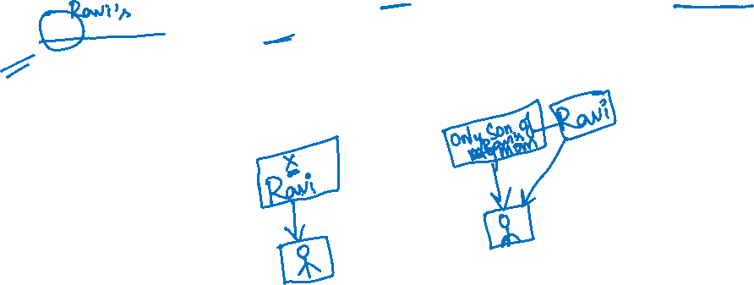
On seeing a photograph of a boy Ravi said, “He is the son of only son my mother”. How is ravi related to boy in the photo?
a) Father b) son c) brother d) Himself

Slide 13
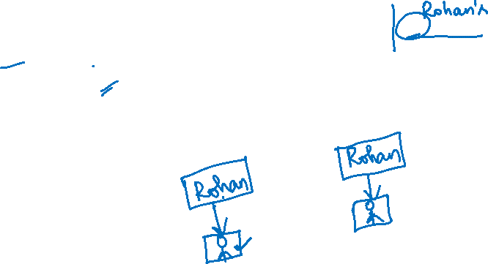
Pointing to a photograph of a boy Rohan said, “I have no brother or sister but that fellows father is my father’s son”. Whose photo is it?
a) His father b) His son c) His brother d) Himself

Slide 14
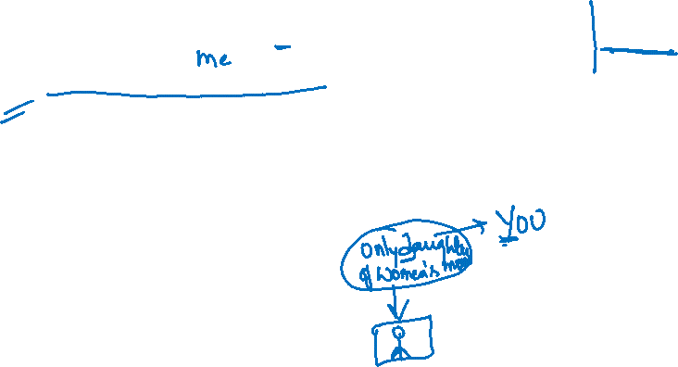
Pointing to a man, a women said, “His mother is the only daughter of my mother”. How is the women related to man?
a) Mother b) Grand mother c) Sister d) Daughter

Slide 15

Pointing to a man in the photograph, Santhosh said, he is the only son of my mother’s father. How is Santhosh related to man in the photo?
a) Aunt b) Nephew c) Daughter d) Mother

Slide 16

Rama says pointing to Kapil, "He is the only son of my father.“ How is Rama related to Kapil?
a. Daughter b. Mother c. Sister d. Aunt

Slide 17
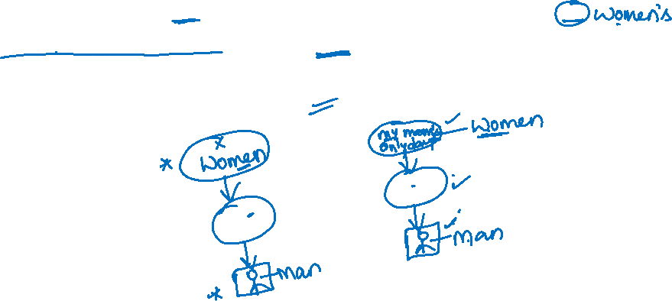
Pointing to a man, a woman said, ”his mother is daughter of my mother’s only daughter”. How is man related that woman?
a) Son b) Father c) Brother d) Grand son

Slide 18

Pointing to a man, a woman said, “his father is the son of my mother”. How is woman related to man?
a) Mother b) grand mother c) sister d) aunt

Slide 19
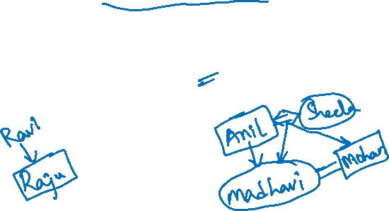
In a family Raju is son of Ravi. Madhavi is daughter of anil. Sheela is mother of madhavi. Mohan is brother of madhavi. How is Mohan related to sheela
a) Brother b) father c) son d) cannot be determined

Slide 20

Introducing a woman, a man said, "She is the only daughter-in-law of my mother.'' How is the woman related to the man?
a. Cousin b. Sister c. Daughter d. Wife

Slide 21

R is the husband of S. T is the only son of S. How is R related to T?
a. Mother b. Brother c. Aunt d. Father

Slide 22

When I met Mr. Harish at a wedding, he pointed out to a person and said, “Sravya is your mother's only sister's son's wife". How is Sravya related to me?
a. Sister-in-law b. Mother c. Niece d. Aunt

Slide 23
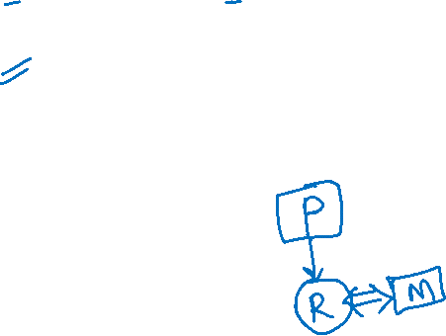
P is the father of R but R is not his son. M is the spouse of R. How is M related to P?
a. Son-in-law b. Wife c. Daughter-in-law d. Uncle

Slide 24
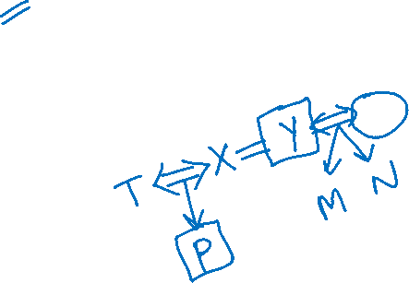
X has a brother Y. T is the spouse of X and P is the only son of X. M and N are children of Y. How is P related to Y?
a. Nephew b. Brother c. Niece d. Daughter

Slide 25
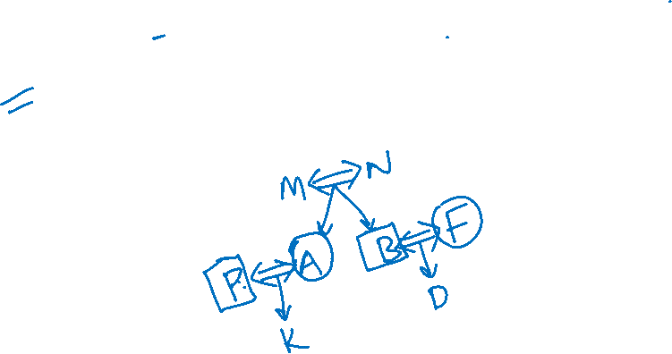
M and N have two children A and B. F is the spouse of B. D is the child of F. P is the son-in-law of N. K is the child of P. Who can be the male child of M and N?
a. B b. D c. A d. K

Slide 26

A man goes to the park and sees a girl who he recognized to be his relative. The girl was the daughter of his sister's husband's wife. How is the girl related to the man?
a. Niece b. Sister-in-law c. Sister d. Aunt

Slide 27
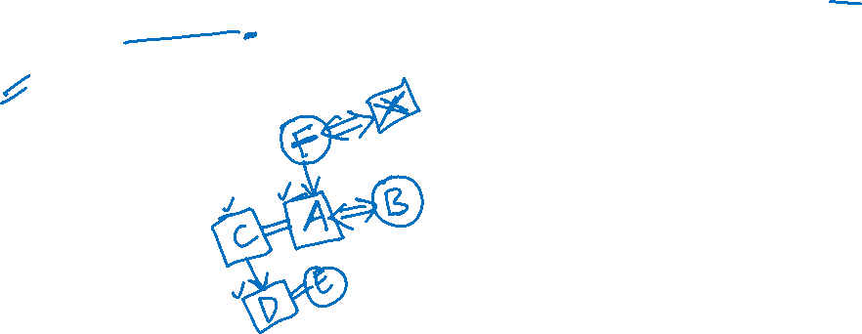
In a family there are 6 members A,B,C,D,E,F. A and B are married couples, A being a male member. D is the only son of C, who is brother of A. E is sister of D. B is daughter-in-law of F, whose husband has died. How many male members are there?
a) 3 b) 4 c) 5 d) 2

Slide 28
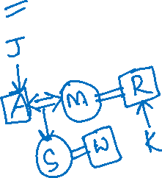
A has 2 children. A is married to M and S is M's daughter. K's father R is M's brother. A is the only son of J. J's grandson is W. How is R related to W?
a. Niece b. Aunt c. Maternal Uncle d. Cousin

Slide 29
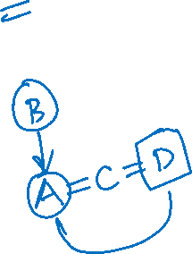
A is B’s daughter. B is C’s mother. D is C’s brother. How is D related to A?
a) Father b) Grand father c) Brother d) Son

Slide 30

Pointing to a women in a photograph a man says “she is the mother of the father of my wife’s only son”. How is women related to man?
a) Aunt b) mother c) sister d) uncle

Slide 31
P is Q’s brother. R is Q’s mother. S is R’s father. T is S’s mother. How is P related to T?
Grand daughter
Great grand son
Grandson
Grand mother

Slide 32
If H is A’s brother, A is G’s sister and G is R’s mother. If R is male then R is H’s?
a) Brother b) Sister c) Nephew d)cousin

Slide 33
Salesman, engineer and accountant. There are two married couples in a family. D, the salesman married to lady teacher. The doctor is married to the lawyer. F, the accountant is the son of B and brother of E. C, the lawyer is daughter-in-law of A. E is unmarried engineer. A is grand mother of F. What is profession of B?
a) Engineer b) Doctor c) Lawyer d) Teacher

Slide 34
U is mother of W, who is wife of Y. X is brother of U. V is husband of U. then how is U related to Y?
a) Sister b) Mother c) Mother-in-law d) Brother-in-law

Slide 35
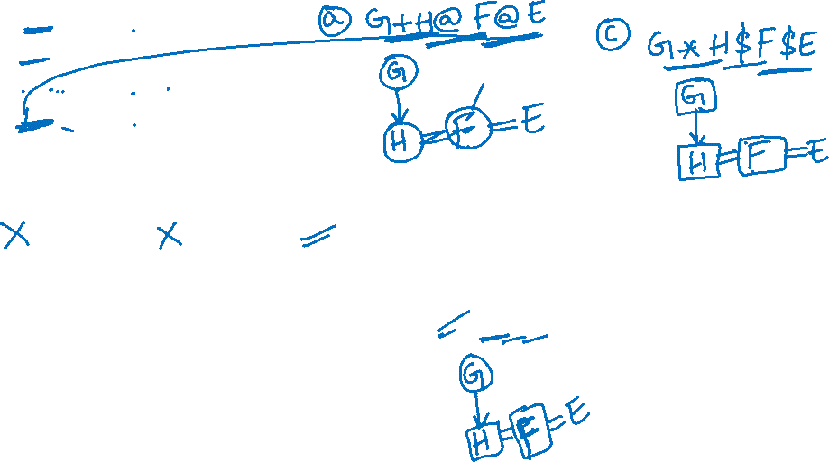
If A+B means A is mother of B
A*B means A is father of B
A$B means A is brother of B
A@B means A is sister of B
Then which of the following means
1) F is son of G
a) G+H@F@E b) G+H*F@E c) G*H$F$E d) G*H$F@E
2) G is mother of E
a) G*H@F@E b) G$H@F@E c) G+H*F*E d) G+H$F$E

Slide 36

If P @ Q - R * S, then how is R related to Q?
A @ B means A is the mother of B.
A * B means A is the father of B.
A % B means A is the son of B.
A - B means A is the daughter of B.
a. Uncle b. Father c. Grandfather d. Brother

Slide 37
MIND BENDER

Slide 38

Looking at a picture, X said that the lady in the picture is her father's mother's mother-in-law's only daughter-in-law's only granddaughter. Who is the lady in the picture?
a. X herself b. X's grandmother c. X's mother d. X's daughter

Slide 39
Thank You
Best ahead!!

